Slide 1
Optimizing Neural Network Structures
Research or Master Thesis Project
Topic: Optimize neural network structures using surrogate model optimization
Scientific Challenges (Research Project): Surrogate assisted neuro-evolution
Scientific Challenges (Master Thesis Project): Optimizer for generic neural network structures
Student Profile CS/DS/Bio-Informatics – Neural Networks course
Time frame can start immediately
Advisors Supervisor: Bas van Stein / Thomas Bäck
Everyday-supervisors: Bas van Stein
Information: b.van.stein@liacs.leidenuniv.nl
Office Nr. :113

Slide 2
Benchmarking Optimization Algorithms Using IOHprofiler
Thomas Bäck, Hao Wang June 27, 2019

Slide 3
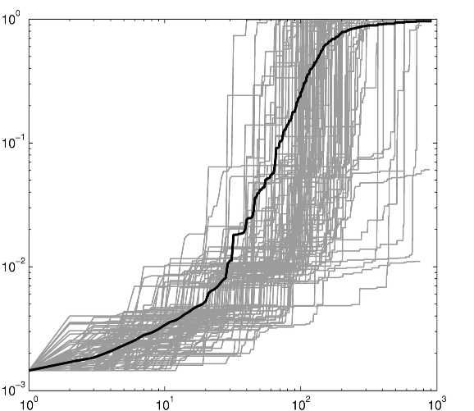
Benchmarking Optimization Algorithms
Performance Measures
Algorithms:
Genetic algorithm
Particle swarm algorithm
Differential evolution
Brain storm optimization…
Pigeon-Inspired Optimizer…
…
Objective value
runtime

Slide 4
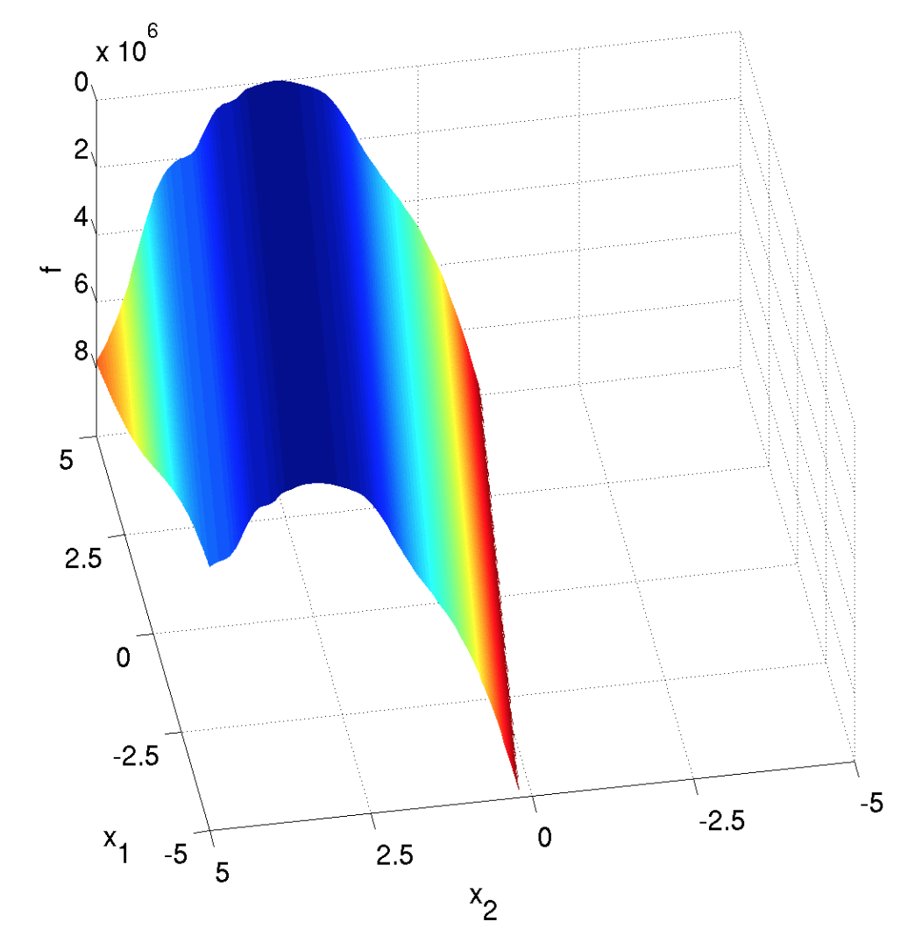
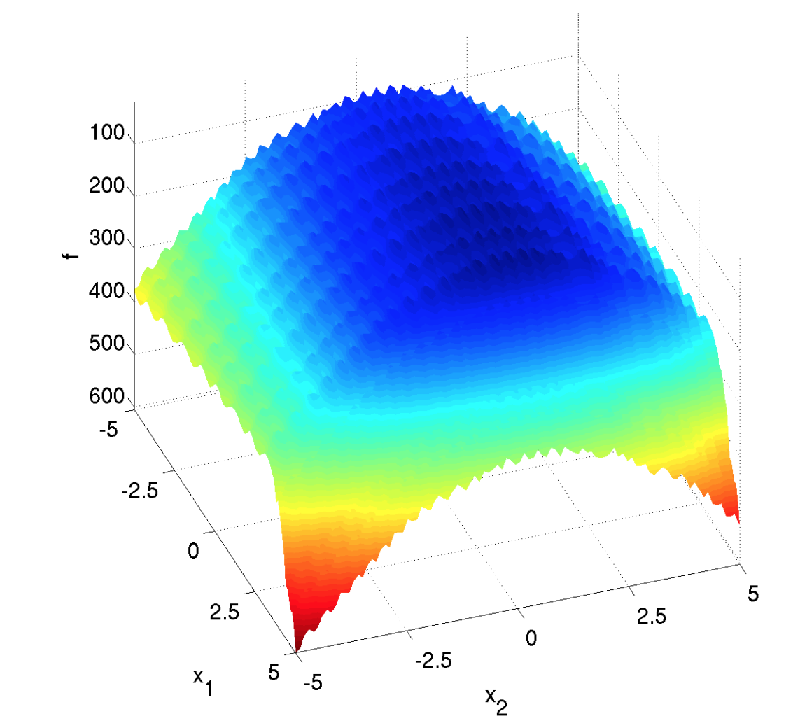
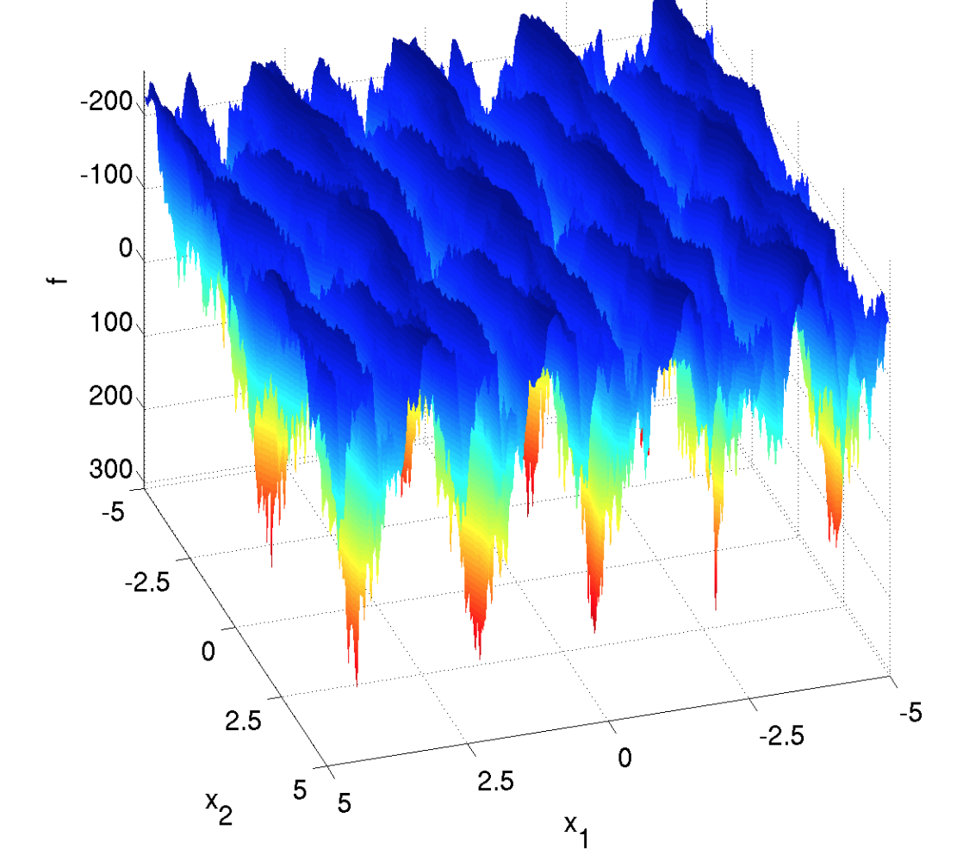
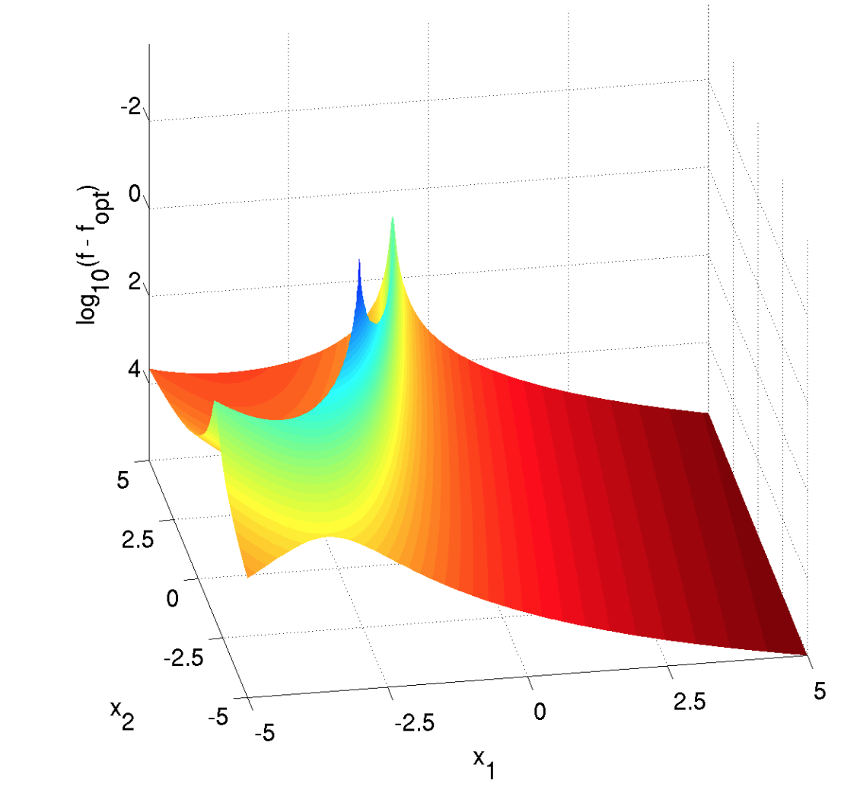
Benchmarking Optimization Algorithms
Benchmark problems
COCO / BBOB: Black-Box Optimization Benchmarking
IOHprofiler: Iterative Optimization Heuristic Profiler
IOHexperimenter
IOHanalyzer: iohprofiler.liacs.nl

Slide 5
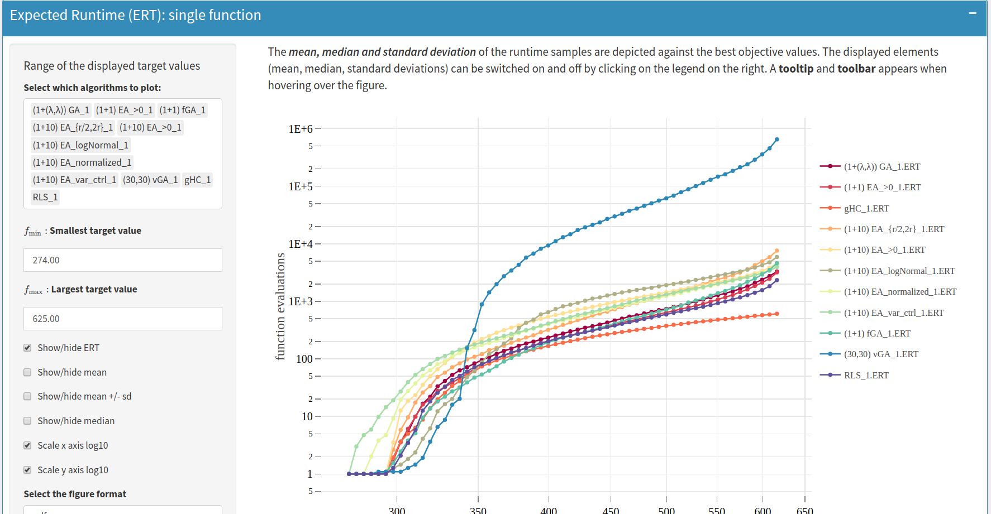
IOHanalyzer – Interactive Visualization
Expected running time

Slide 6
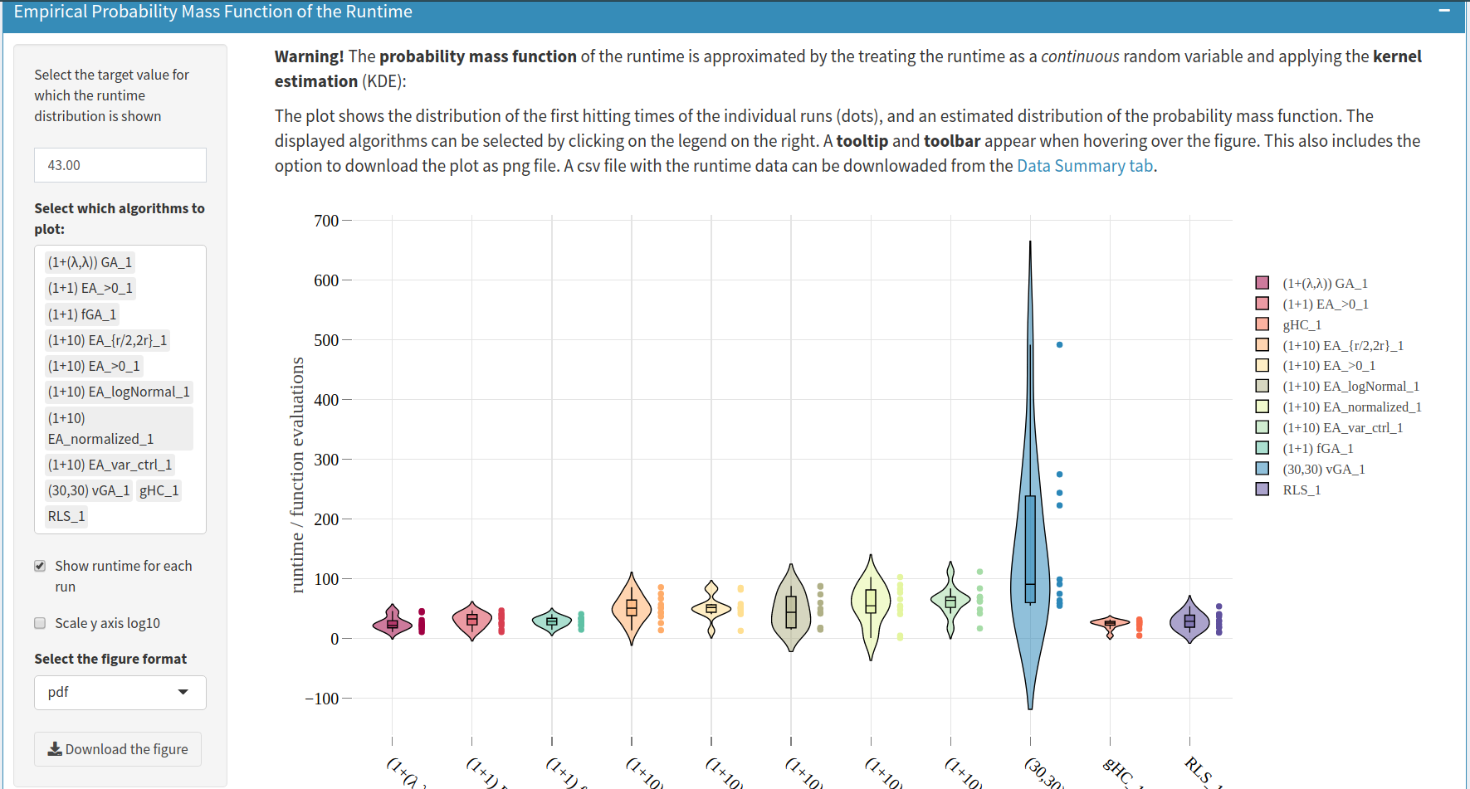
IOHanalyzer – Interactive Visualization
Probability density function of the running time

